Slide 1
TradeWise: Stock Strategy Analysis
Data-Driven Review & Recommendations
Praveen Raj S
25.11.2025

Slide 2

行业PPT模板http://www.1ppt.com/hangye/
INTRODUCTION
A stock represents ownership in a publicly listed company and is traded on a stock exchange.
Trade refers to the process of buying or selling shares between a buyer and seller at an agreed price.​
Trading stocks enables investors to potentially earn profits from short-term price movements and market fluctuations.​
Stock trades are executed online or through brokers, and help provide liquidity in the financial markets.

Slide 3

行业PPT模板http://www.1ppt.com/hangye/
OBJECTIVES
Analyze top 20 Nifty 50 stocks using 5 years of historical data
Apply technical strategies and performance metrics
Generate actionable investment insights

Slide 4

行业PPT模板http://www.1ppt.com/hangye/
Stock Data
Date: Trading day timestamp
Open, High, Low, Close: Daily prices
Volume: Number of shares traded
Stock: Stock symbol

Slide 5
行业PPT模板http://www.1ppt.com/hangye/
Data Cleaning
Removed duplicate records and null values
Verified date consistency and ensured proper sorting
Standardized stock symbols and price formats
Validated volume and price ranges for outliers
Ensured 5-year historical data completeness for all 20 stocks

Slide 6

行业PPT模板http://www.1ppt.com/hangye/
Methodology
Tools & Libraries
Python
Pandas
Numpy
Matplotlib
Seaborn
Techniques Applied
Moving Average Crossover
Technical Indicators
Risk Return Analysis

Slide 7
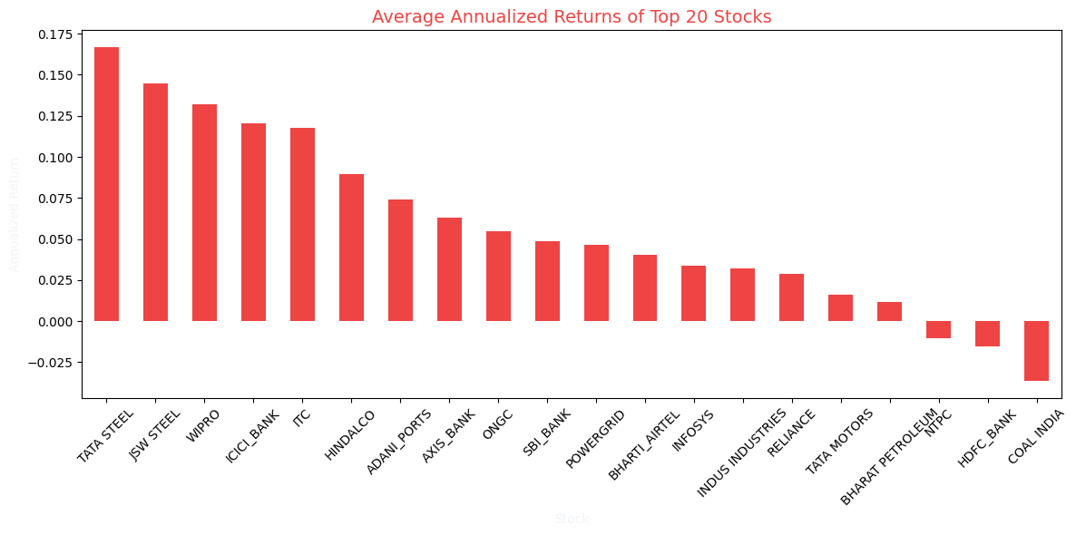
Annualized Returns Comparison
TATA STEEL delivered the highest annualized return among the top 20 stocks, making it a strong performer for long-term growth.
JSW STEEL , WIPRO , and ICICI BANK also showed robust annualized returns, indicating steady gains.
Stocks such as COAL INDIA , HDFC BANK , and NTPC had the lowest or negative annualized returns, suggesting underperformance over the period.
Most stocks in the middle range provided moderate but consistent growth, which could help diversify risk if included in a portfolio.
Focus new investments on high-performing stocks like TATA STEEL , JSW STEEL , and WIPRO , which have shown the most consistent growth.

Slide 8
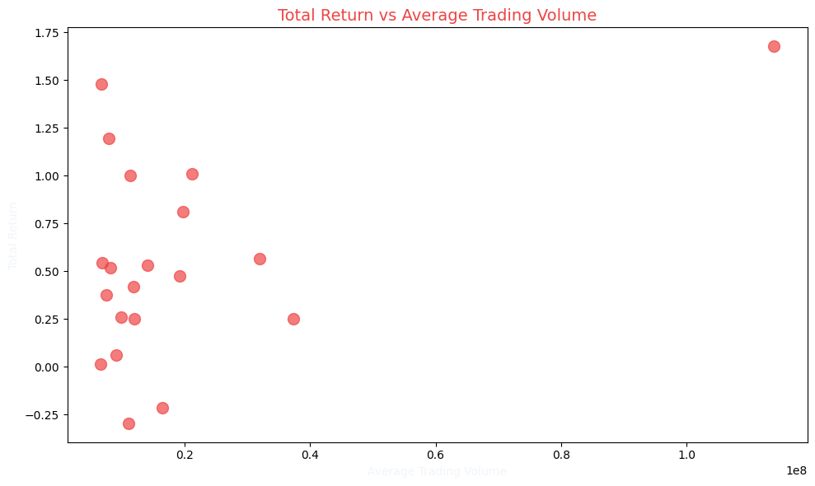
Total Return vs Trading Volume
Most stocks with high total returns did not necessarily have the highest trading volumes.
A few stocks delivered strong returns even at low or moderate trade volumes, showing that volume alone does not guarantee growth.
The visible clustering suggests most top-performing stocks trade in a similar moderate volume range.
Prioritize stock selection based on both return and consistent trade volume, not volume alone.
Review high-return, moderate-volume stocks for their suitability in long-term strategies.
Incorporate volume analysis when timing entries and exits, but do not depend solely on volume to pick winners.

Slide 9
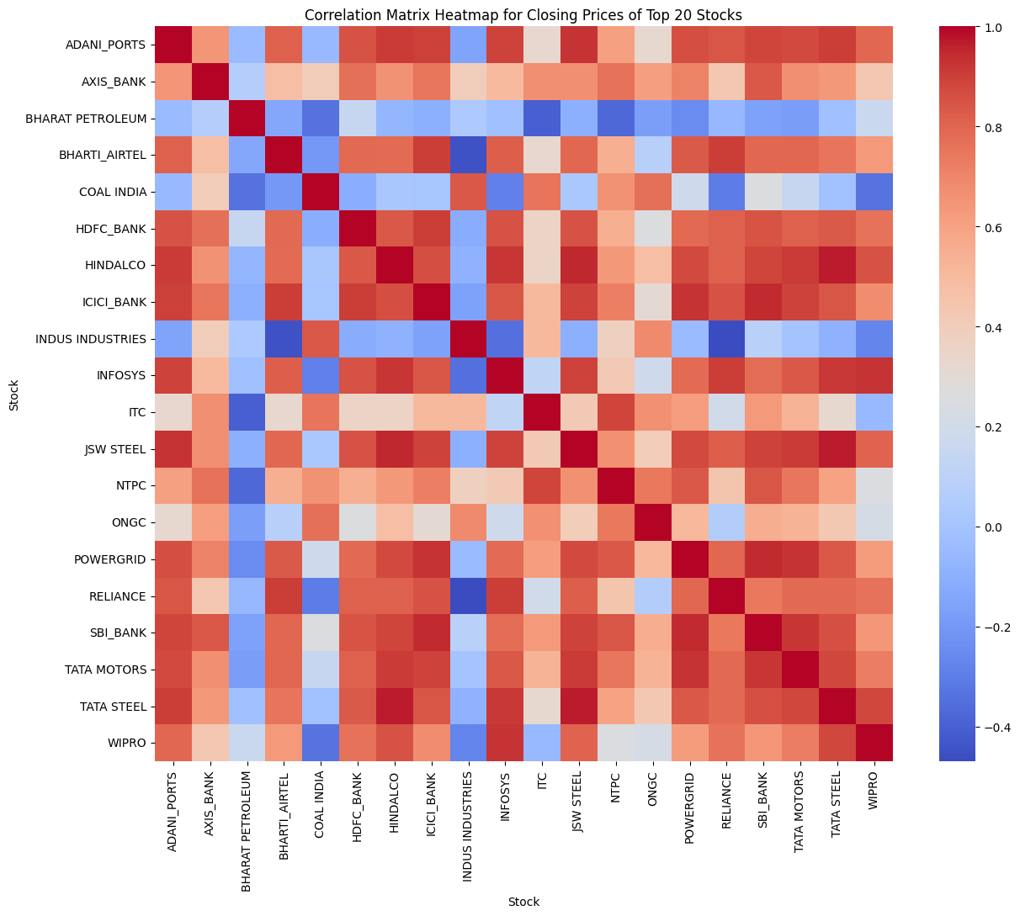
Correlation Heatmap
Some stocks, like ICICI BANK , AXIS_BANK , and SBI_BANK , have strong positive correlations, meaning their prices often change together.
A few pairs, such as TATA STEEL and JSW STEEL, also display high correlation, likely because they share similar market drivers.
Some stocks, such as COAL INDIA and WIPRO , show weaker or even negative correlation to most other stocks, making them good choices for diversification.
Pair highly correlated stocks only for short-term trading strategies, not for long-term diversification.
For lower portfolio risk, include stocks that show weaker correlations to others, such as WIPRO and COAL INDIA .

Slide 10
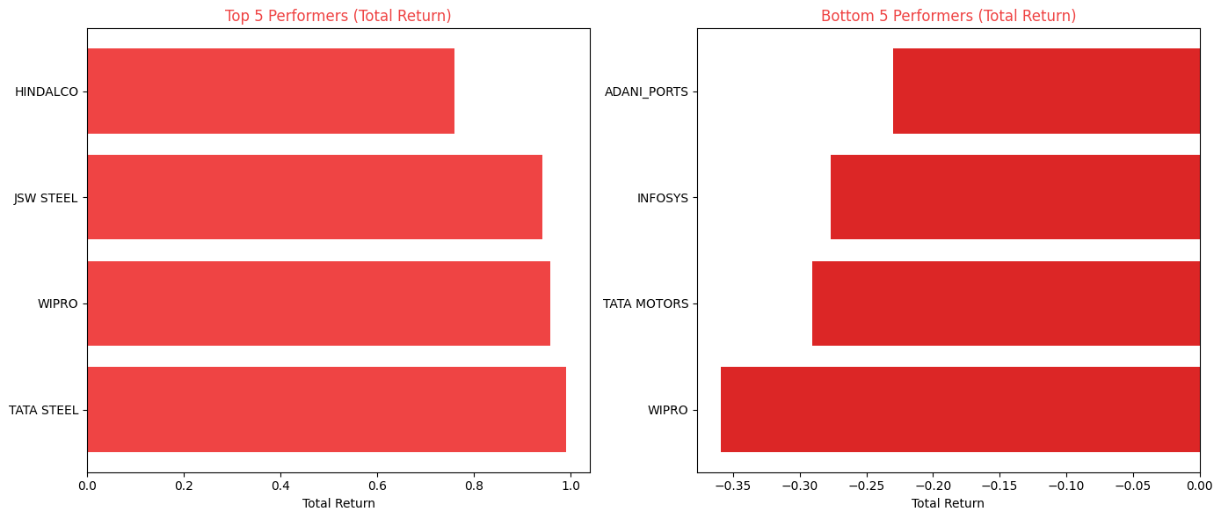
Best Performers
TATA STEEL, WIPRO, JSW STEEL, and HINDALCO all achieved strong total returns over the analysis period.
These stocks consistently outperformed many of their peers, indicating effective growth and opportunity for investors.
Metals and industrial stocks (TATA STEEL, JSW STEEL, HINDALCO) dominated among the highest returns, highlighting sector trends during the period.
Consider prioritizing investments in leading performers like TATA STEEL, JSW STEEL, WIPRO, and HINDALCO, based on their strong track record.
Diversify across these top stocks rather than concentrating in a single name to spread risk and capture upside potential.

Slide 11
Worst Performers
ADANI_PORTS, INFOSYS, TATA MOTORS, and WIPRO recorded negative total returns over the analyzed period.
These stocks underperformed compared to their peers, indicating challenges in generating profits for investors.
Consistent negative returns suggest these stocks faced either sector-specific pressures or company-specific issues affecting growth.
Limit new investments in stocks with historical negative returns unless there is strong evidence of a turnaround.
Review the financial health and business outlook of these companies before considering further exposure.

Slide 12
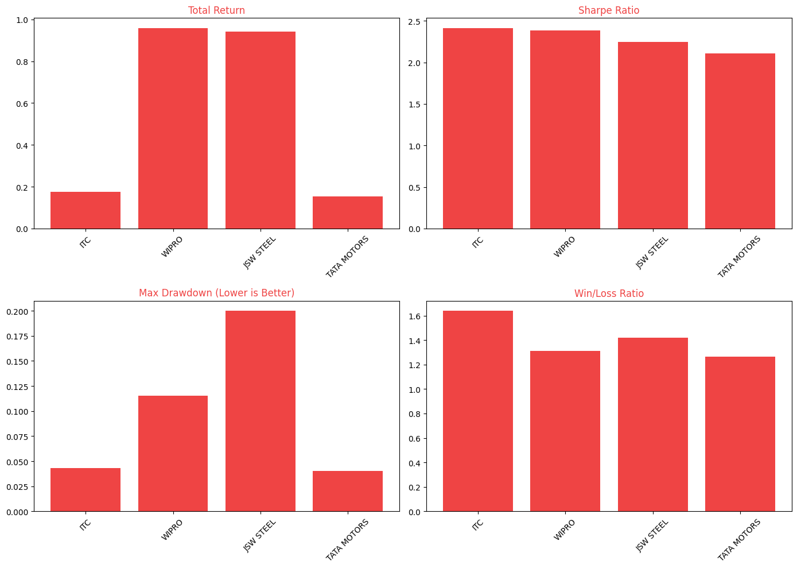
Top Investment Recommendations
WIPRO and JSW STEEL produced the highest total returns in the group, outpacing ITC and TATA MOTORS .
ITC achieved the best risk-adjusted performance, posting the highest Sharpe ratio and the lowest maximum drawdown, signaling strong stability.
Win/loss ratios are highest for ITC and JSW STEEL, showing frequent successful trades.
JSW STEEL displayed the greatest drawdown, indicating higher risk compared to other top performers.

Slide 13
行业PPT模板http://www.1ppt.com/hangye/
Conclusion
Top Performers: TATA STEEL, JSW STEEL, WIPRO, HINDALCO delivered highest returns
Risk-Adjusted Winners: ITC, ICICI BANK balanced growth with stability
Avoid: Steer clear of COAL INDIA, NTPC with consistent underperformance
Diversify Wisely: Mix correlated and uncorrelated stocks for optimal portfolio balance
Trade Volume Matters: Higher volume doesn't guarantee better returns focus on fundamentals
Strategy Works: Moving average crossover successfully captured trends for top performers
This analysis supports data-driven choices for strategic positioning, service optimization, and market expansion in the Trade Wise Stock Strategy .

Slide 14
2025
Thank you
Praveen Raj S
25.11.2025

